Slide 1
Building Arduino Applications
Dr. Abdelhameed Ibrahim Assoc. Prof. Computer Engineering

Slide 2
Day 1
Welcome to the course!
During Day 1,
We are going to introduce you to the course.
How to assemble a circuit on a breadboard circuit?
Let us get acquainted with Arduino
Development tools for Arduino IDE
First glance at a program
First coded material
Macro definitions, variables, counting loops.

Slide 3
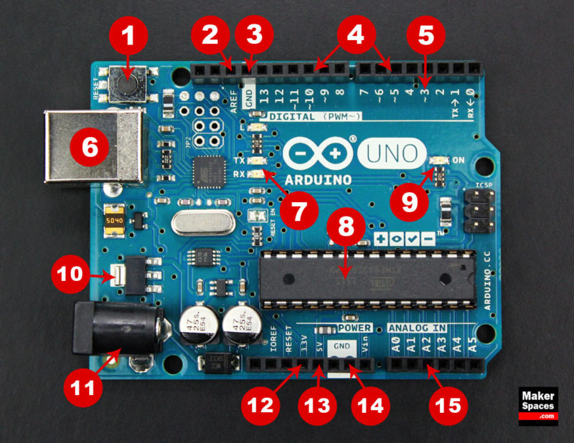
Arduino Uno

Slide 4
Board Breakdown
Here are the components that make up an Arduino board and what each of their functions are:
Reset Button – This will restart any code that is loaded to the Arduino board.
AREF – Stands for “Analog Reference” and is used to set an external reference voltage
Ground Pin – There are a few ground pins on the Arduino and they all work the same
Digital Input/Output – Pins 0-13 can be used for digital input or output
PWM – The pins marked with the (~) symbol can simulate analog output
USB Connection – Used for powering up your Arduino and uploading sketches
TX/RX – Transmit and receive data indication LEDs

Slide 5
Board Breakdown
8. ATmega Microcontroller – This is the brains and is where the programs are stored
9. Power LED Indicator – This LED lights up anytime the board is plugged in a power source
10. Voltage Regulator – This controls the amount of voltage going into the Arduino board
11. DC Power Barrel Jack – This is used for powering your Arduino with a power supply
12. 3.3V Pin – This pin supplies 3.3 volts of power to your projects
13. 5V Pin – This pin supplies 5 volts of power to your projects
14. Ground Pins – There are a few ground pins on the Arduino
15. Analog Pins – These pins can read the signal from an analog sensor and convert it to digital

Slide 6
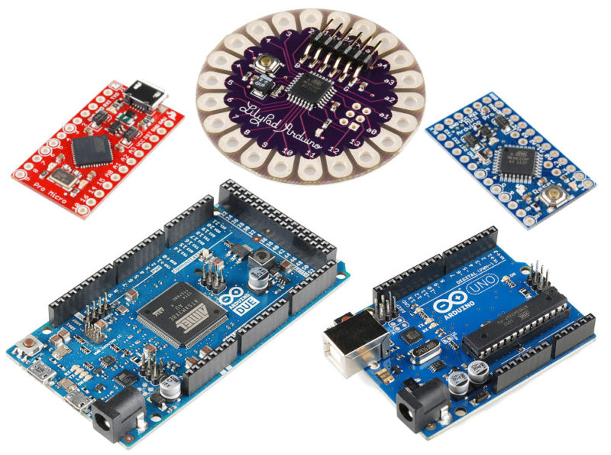
Types of Arduino Boards

Slide 7
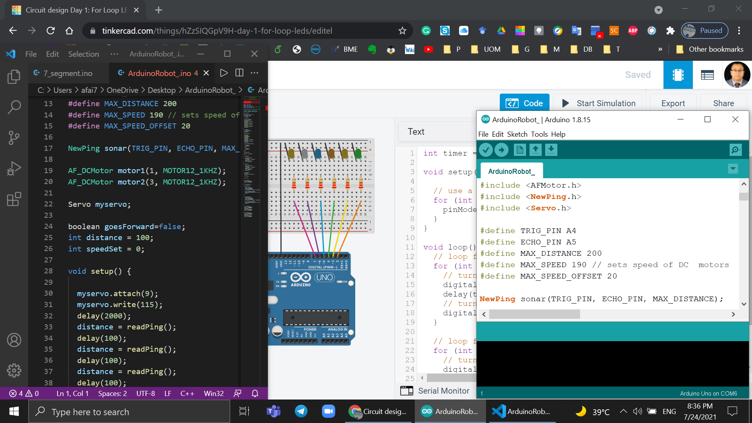
How To Program Arduino
https://www.arduino.cc/
https://code.visualstudio.com/
https://www.tinkercad.com/dashboard
https://www.sites.google.com/site/unoardusim/services

Slide 8
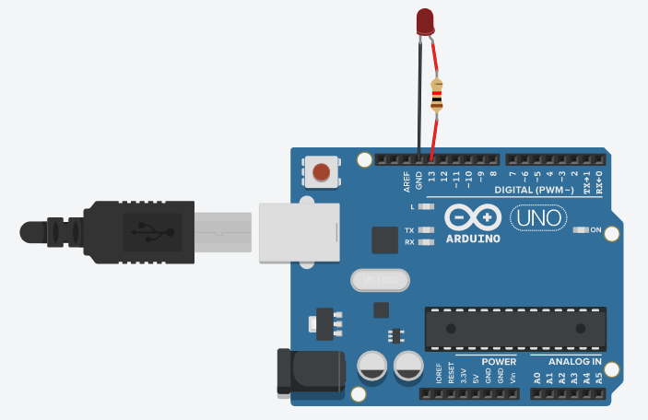
List of experiments
TUTORIALS > Built-In Examples > 01.Basics > Blink
TUTORIALS > Built-In Examples > 03.Analog > Fading

Slide 9
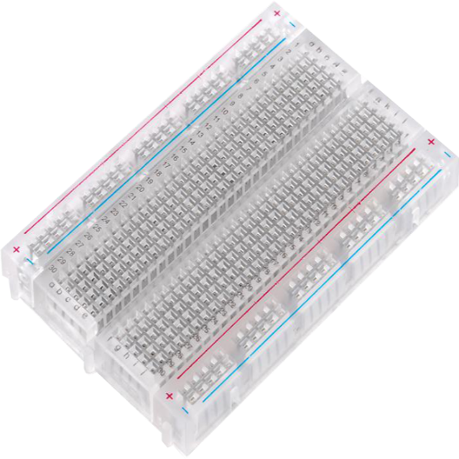
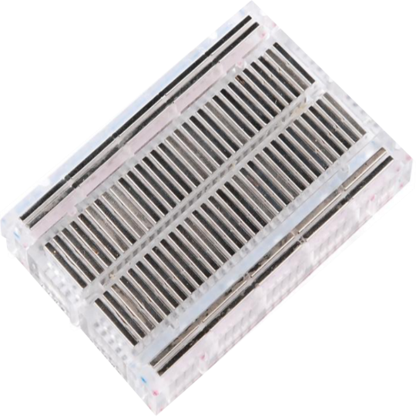
What’s a Breadboard?

Slide 10
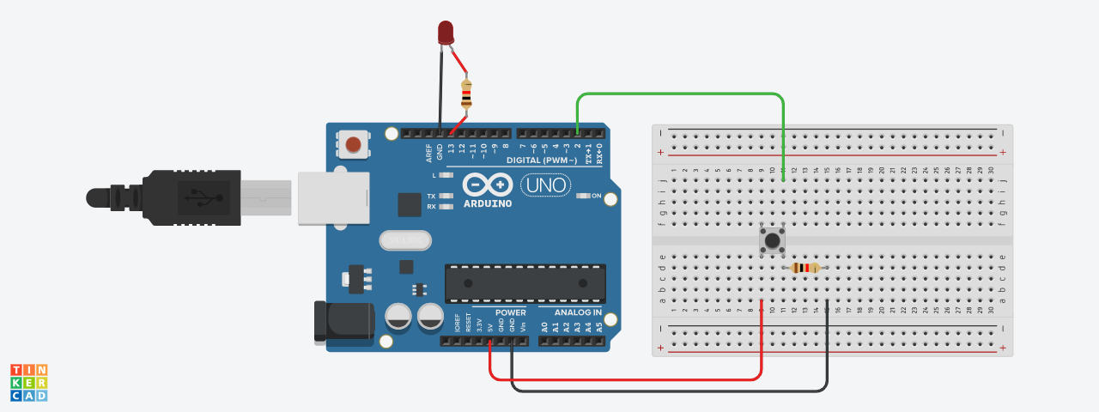
TUTORIALS > Built-In Examples > 02.Digital > Button
TUTORIALS > Built-In Examples > 02.Digital > StateChangeDetection

Slide 11
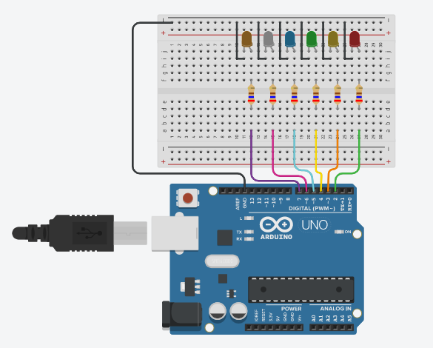
TUTORIALS > Built-In Examples > 05.Control > ForLoopIteration

Slide 12
Day 2
It’s time to learn how to receive data with the help of sensors.
During Day 2,
First sensor
How to read off analog signals
Reading off digital signals
Boolean expressions and program branching
Seven-segment display
Usage of modules and RGB sensor
Joystick app and testing

Slide 13
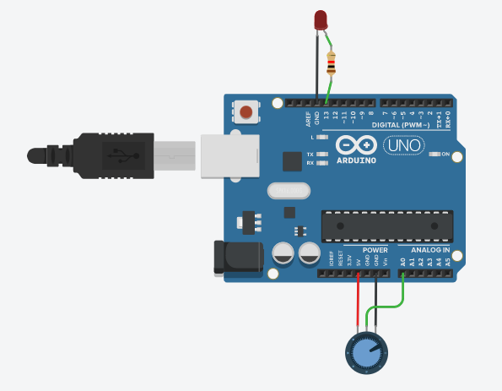
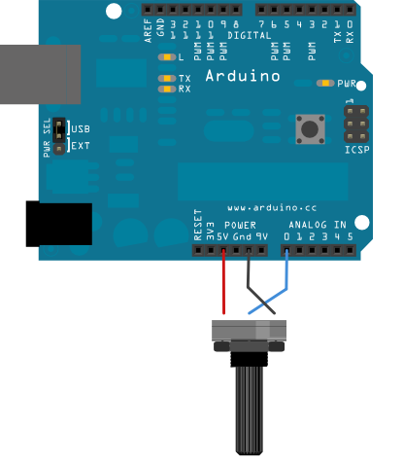
List of experiments
TUTORIALS > Built-In Examples > 03.Analog > AnalogInput

Slide 14
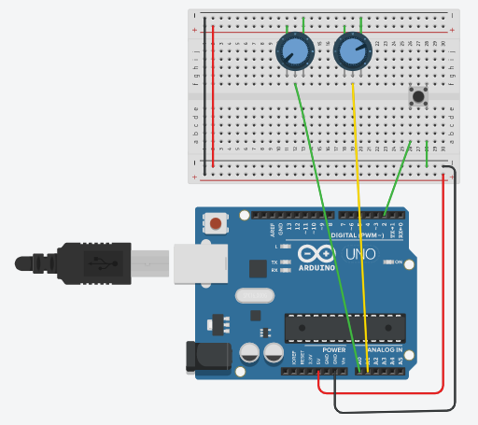
Joystick Control
Code: Lesson 12 Analog Joystick Module
https://github.com/afai79/Arduino/blob/main/Books/Elegoo.zip

Slide 15
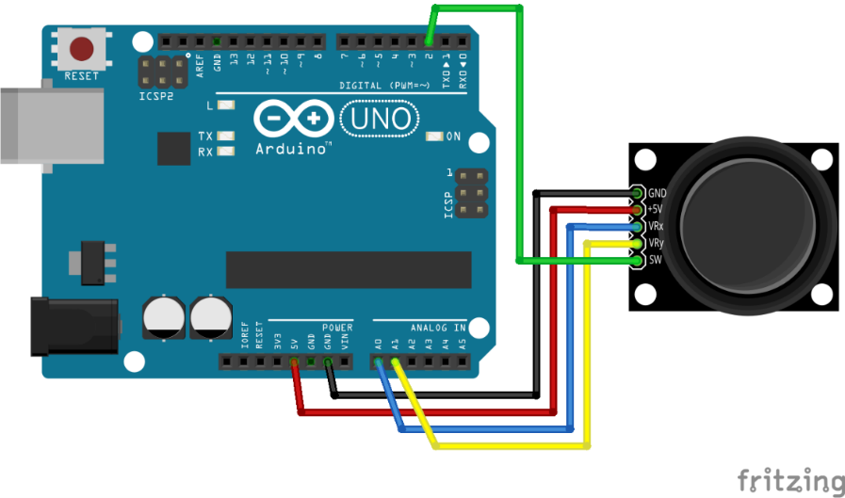
Joystick Control
Code: Lesson 12 Analog Joystick Module
https://github.com/afai79/Arduino/blob/main/Books/Elegoo.zip

Slide 16
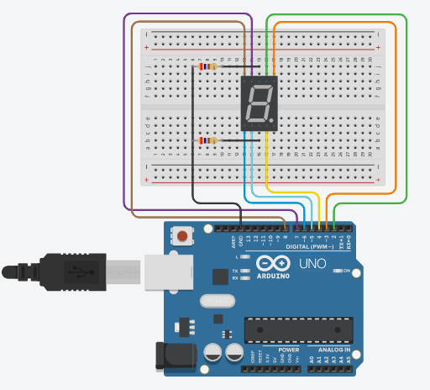
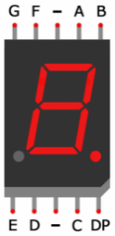
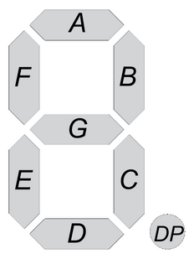
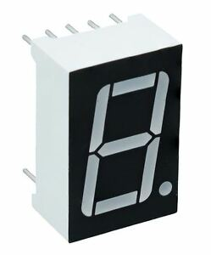
7 Segment
https://github.com/afai79/Arduino/blob/main/7_segment.ino

Slide 17
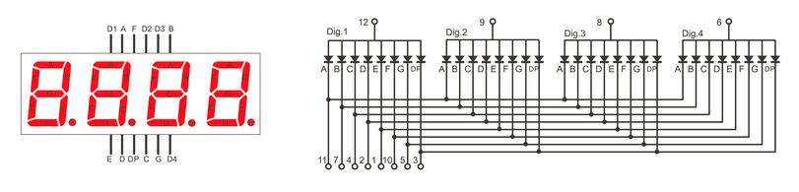
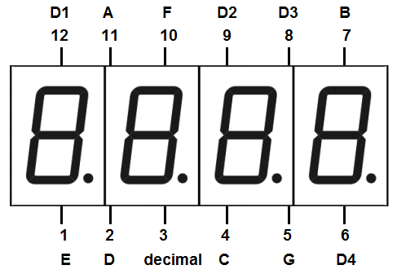
Four Digital Seven Segment Display

Slide 18
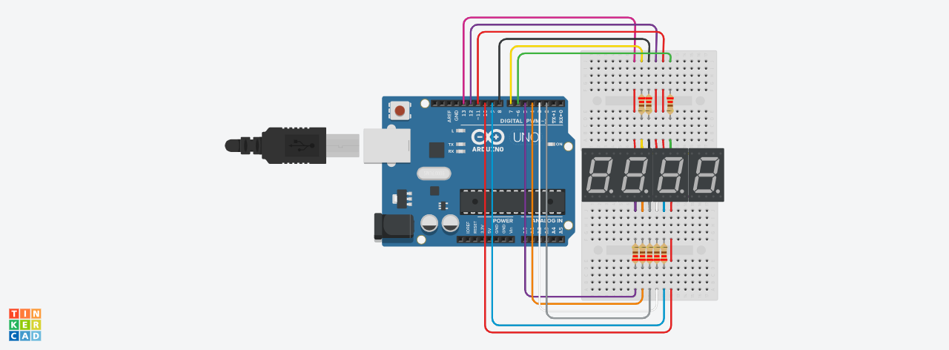
https://github.com/afai79/Arduino/blob/main/4_digit_7_segment.ino

Slide 19
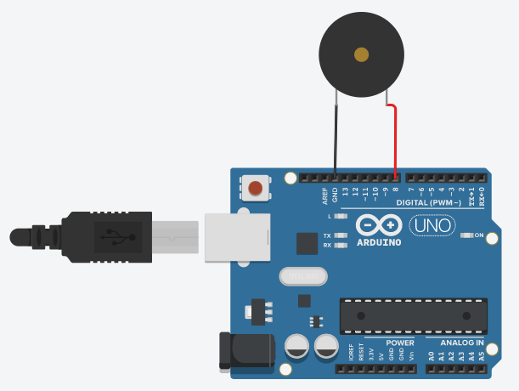
Tone Melody
https://www.arduino.cc/en/Tutorial/BuiltInExamples/toneMelody
https://github.com/afai79/Arduino/blob/main/Lib/pitches.zip

Slide 20
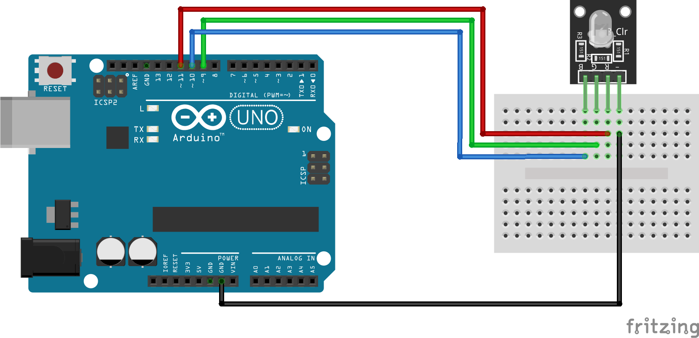
RGB sensor
Code: Lesson 4 RGB LED
https://github.com/afai79/Arduino/blob/main/Books/Elegoo.zip

Slide 21
Day 3
Having learnt to create a step motor, you can create devices which can perform very precise actions. It could as well be just messing with your hand with which you are trying to control it.
During Day 3,
Servo and the library
Ultrasonic Sensor
LCD
Temperature and humidity sensor
Water level Sensor
Step motor
Motor control expansion board
LCD with I2C

Slide 22
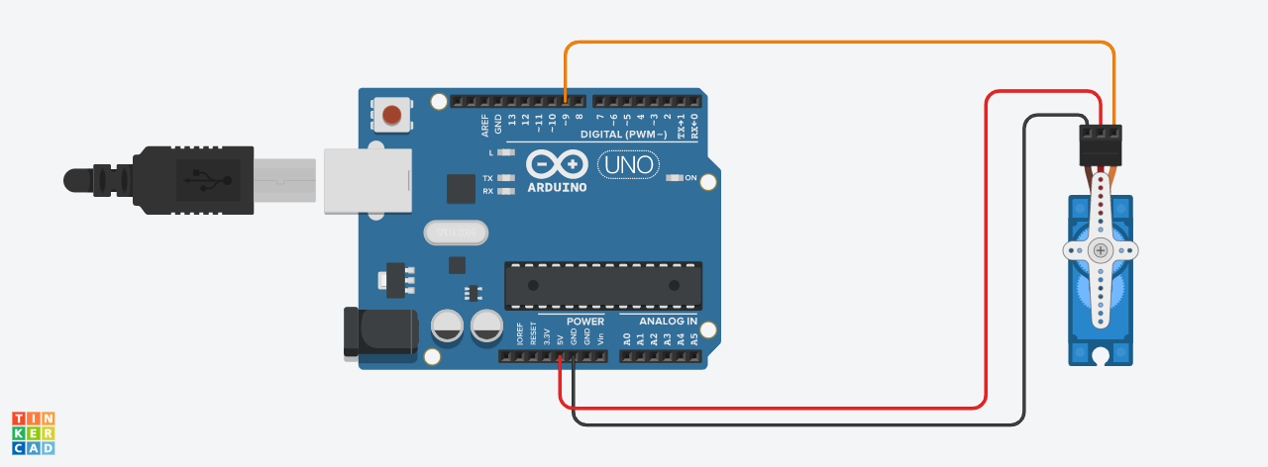
Servo motor control
Code: Lesson 9 Servo
https://github.com/afai79/Arduino/blob/main/Books/Elegoo.zip

Slide 23
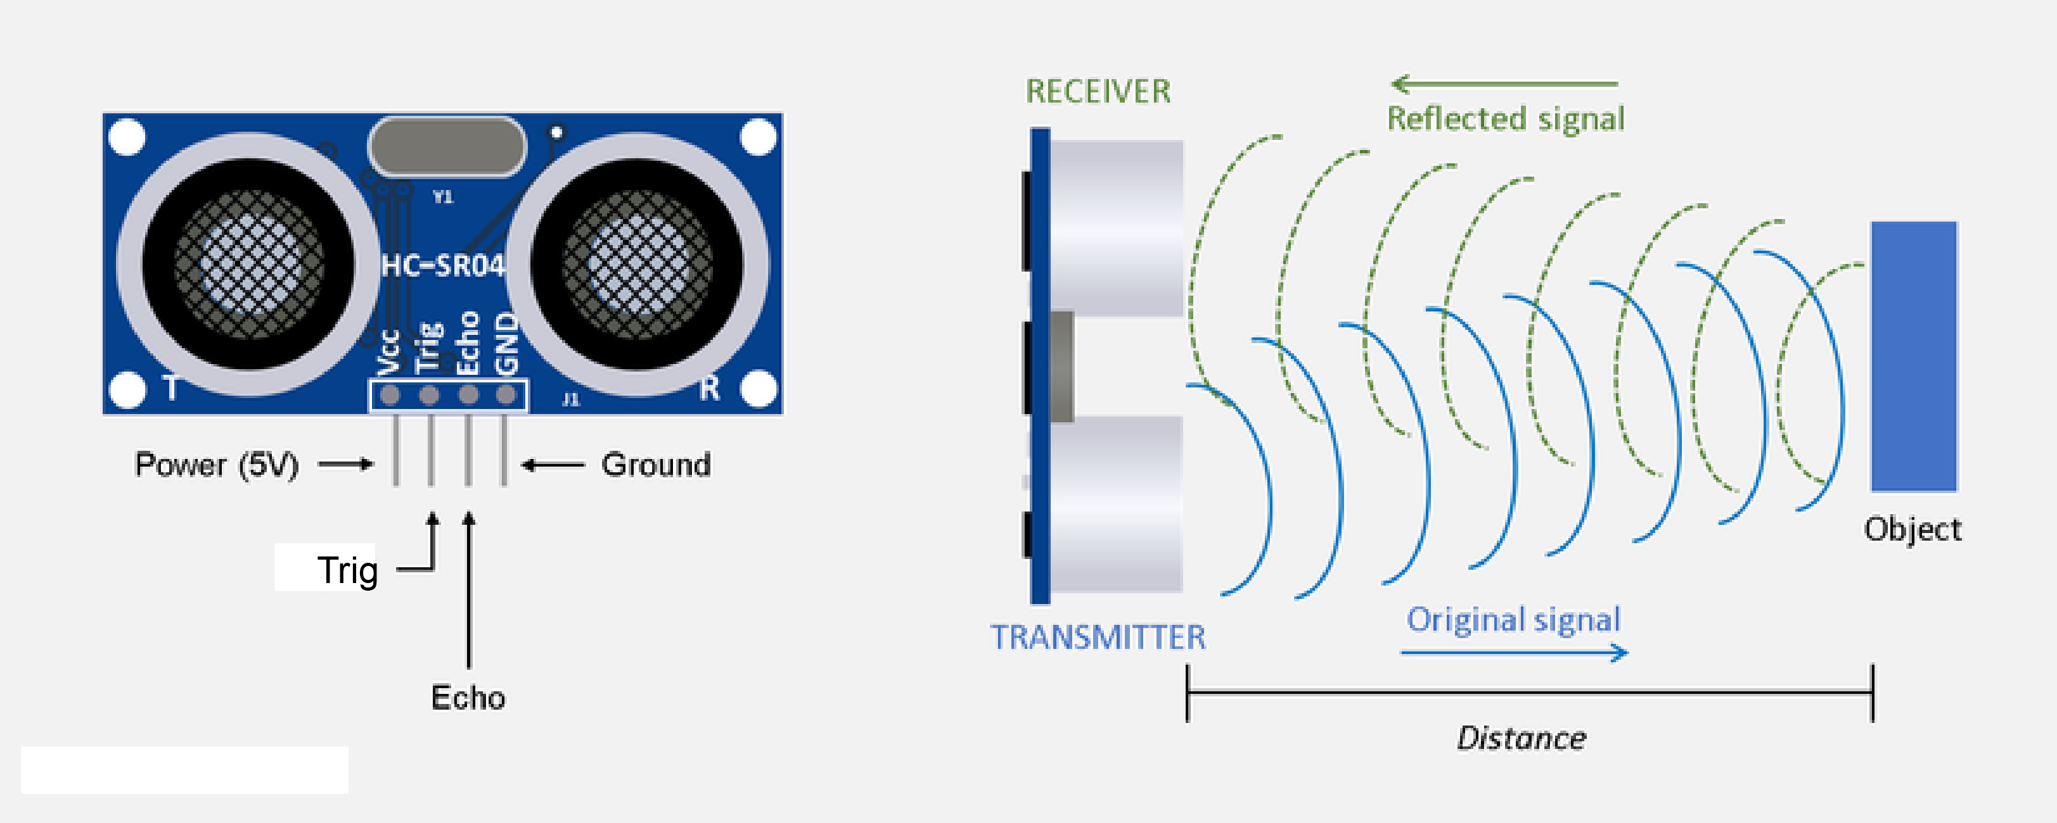
Ultrasonic Sensor

Slide 24
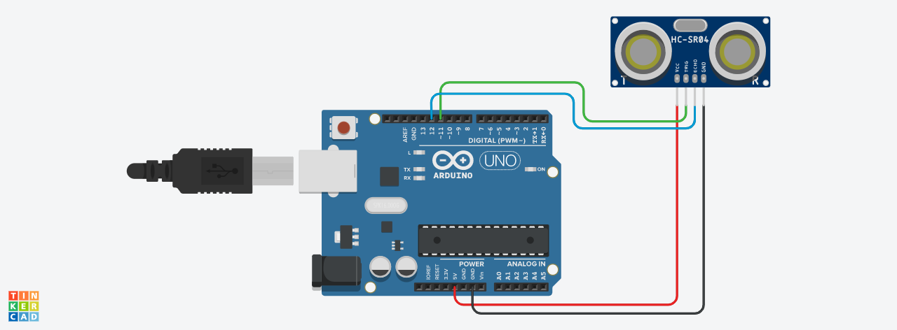
Ultrasonic Sensor
https://github.com/afai79/Arduino/blob/main/Ultrasonic.ino

Slide 25
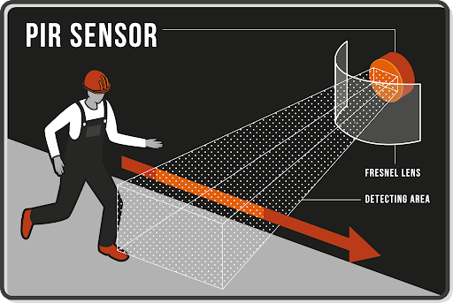
PIR Sensor
https://github.com/afai79/Arduino/blob/main/PIR_Sensor.ino

Slide 26
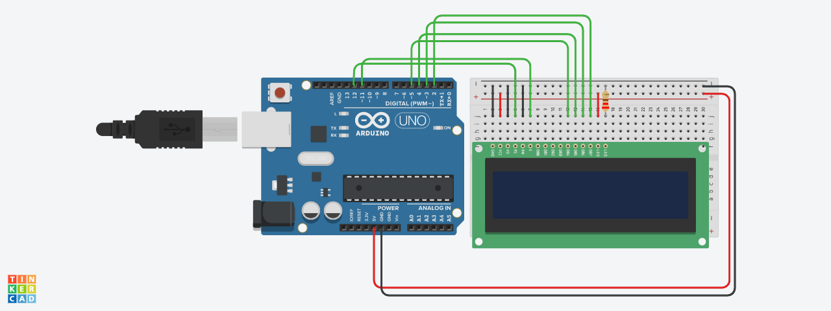
LCD
https://github.com/afai79/Arduino/blob/main/LCD.ino

Slide 27
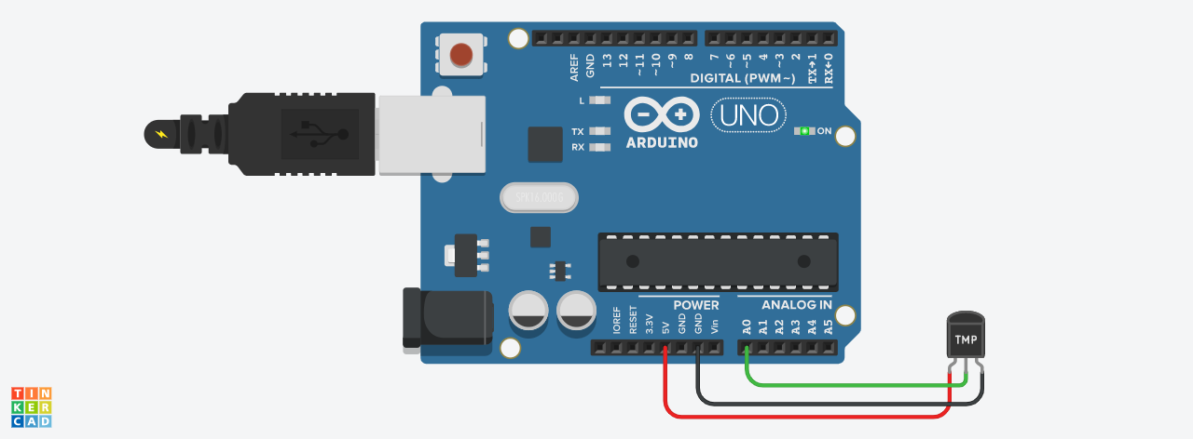
Temperature sensor.
https://github.com/afai79/Arduino/blob/main/Temperature.ino

Slide 28
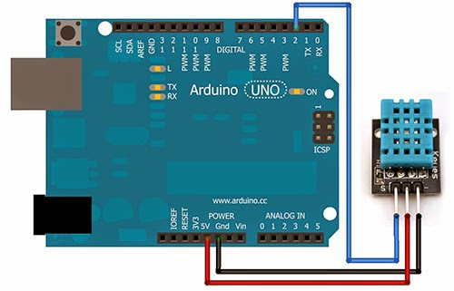
List of experiments
Temperature and humidity sensor.
Code: Lesson 11 DHT11 Temperature and Humidity Sensor
https://github.com/afai79/Arduino/blob/main/Books/Elegoo.zip

Slide 29
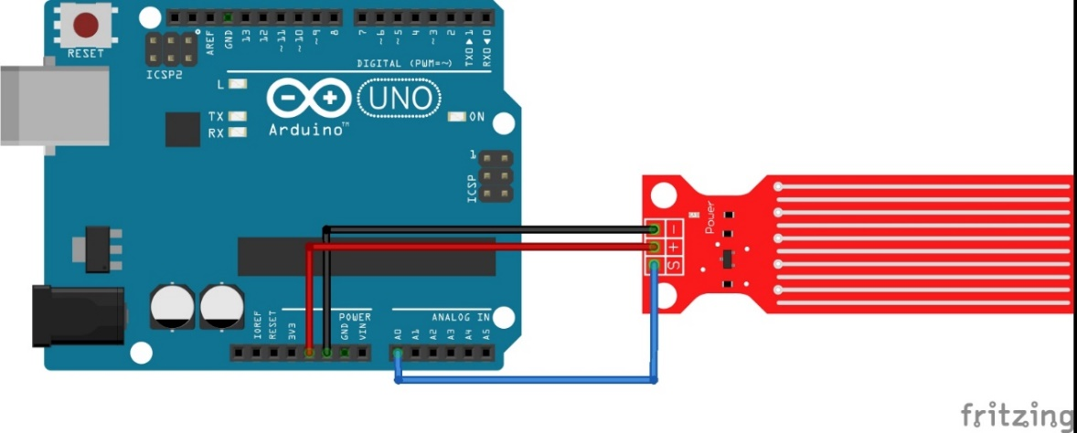
Water level Sensor
https://www.thegeekpub.com/236571/arduino-water-level-sensor-tutorial/
https://github.com/afai79/Arduino/blob/main/water_level.ino

Slide 30
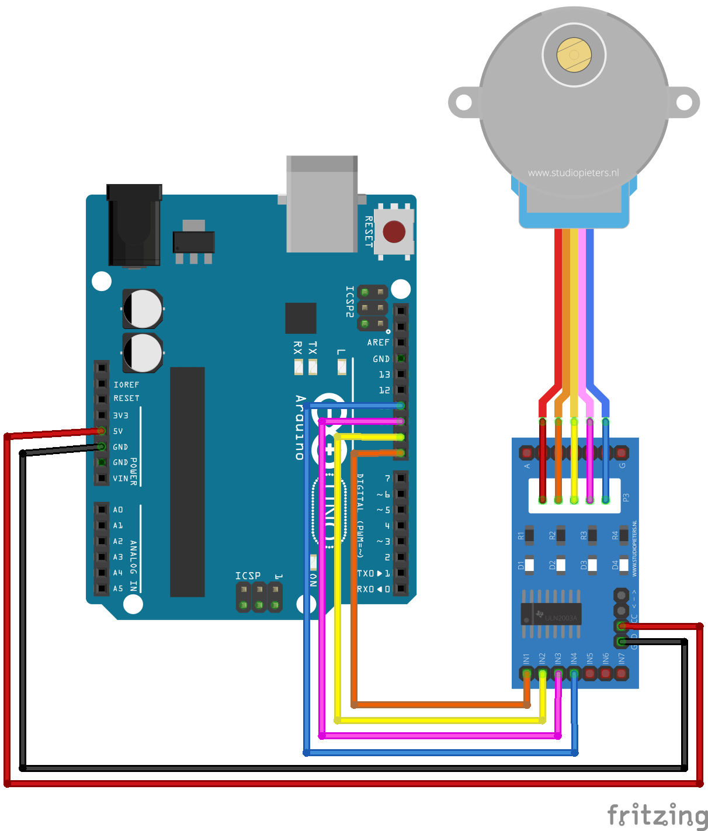
Stepper motor
Code: Lesson 23 Stepper Motor
https://github.com/afai79/Arduino/blob/main/Books/Elegoo.zip

Slide 31
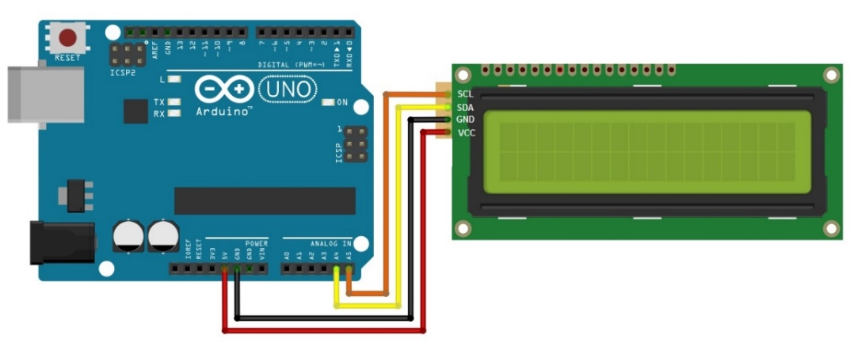
LCD with I2C
https://github.com/afai79/Arduino/blob/main/LCD_I2C.ino

Slide 32
Day 4
Having learnt to use a lot of sensors and devices with Arduino
During Day 4, you are ready to make various small projects based on your skills.
Small Project 1: Air Quality Detector
Small Project 2: Control servo motor by RGB sensor
Small Project 3: Smart House
Small Project 4: BMA400 and MPU6050 sensors-based projects

Slide 33
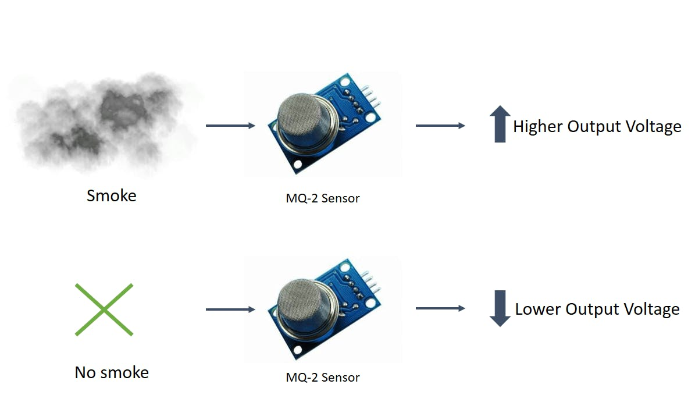
Small Project 1: Air Quality Detector
Gas Sensor

Slide 34
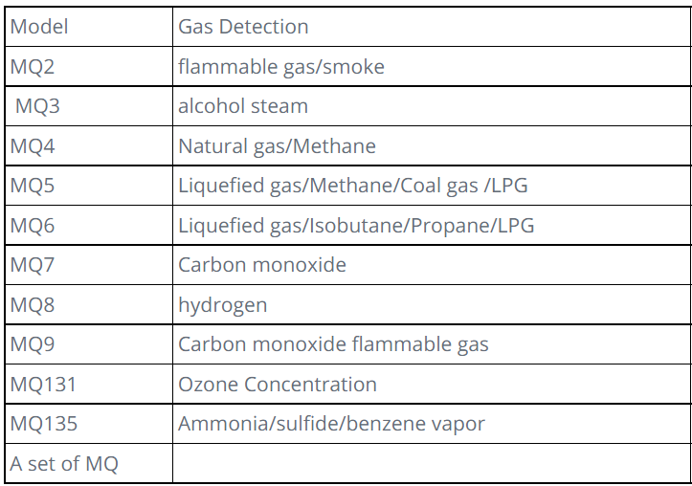

Slide 35
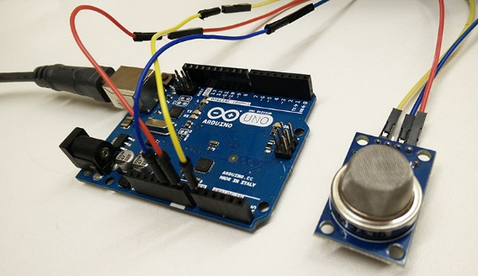
https://github.com/afai79/Arduino/blob/main/Gas_sensor.ino
https://github.com/afai79/Arduino/blob/main/Gas_sensor-LED-Motor.ino

Slide 36
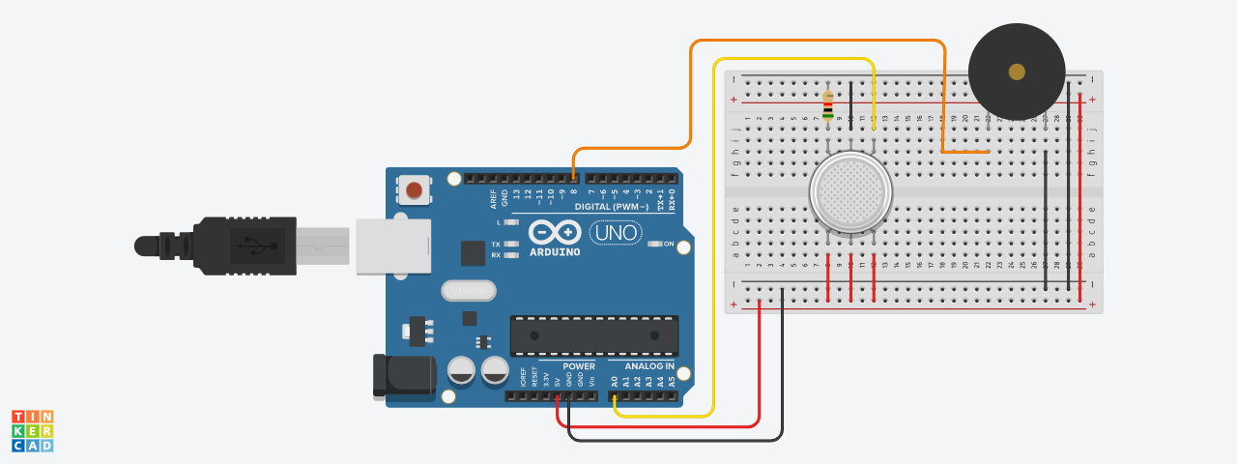
https://github.com/afai79/Arduino/blob/main/Gas_Piezo.ino

Slide 37
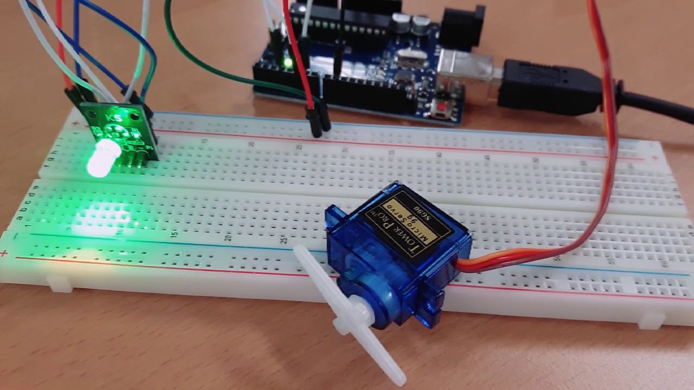
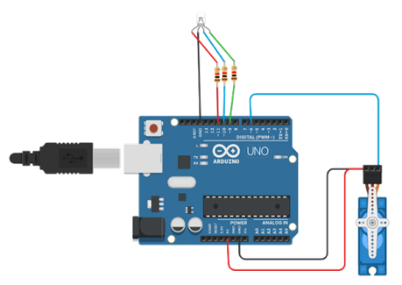
Small Project 2: Control servo motor by RGB sensor
https://github.com/afai79/Arduino/blob/main/RGB_LED-motor.ino

Slide 38
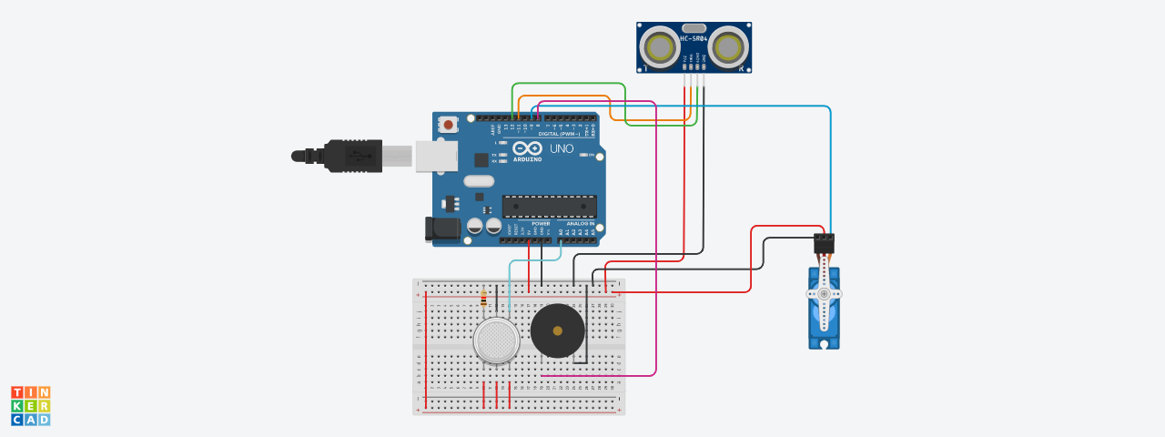
Small Project 3: Smart House
https://github.com/afai79/Arduino/blob/main/Ultrasonic_Servo_Gas_P.ino

Slide 39
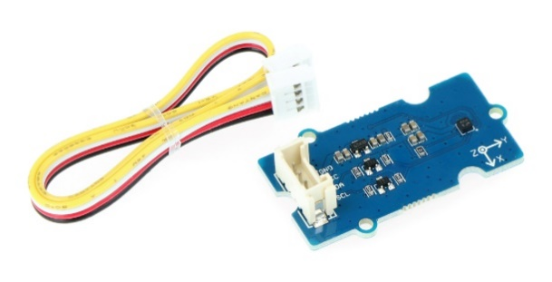
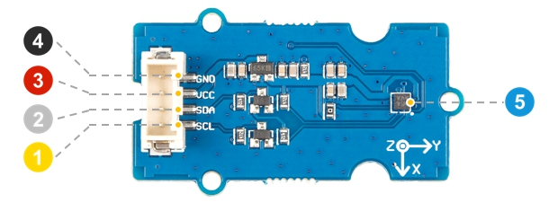
Small Project 4: BMA400 and MPU6050 sensors-based projects
Grove - 3-axis digital accelerometer ±16 g low power (BMA400)
PIN | DESCRIPTION
1. | SCL - clock line I2C
2. | SDA - I2C data line
3. | System power supply from 3.3 V to 5 V
4. | System weight
5. | BMA400 module

Slide 40
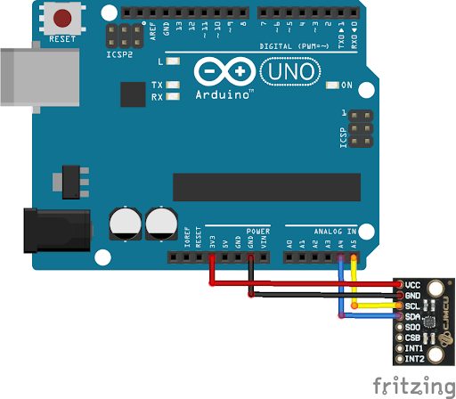
https://github.com/afai79/Arduino/blob/main/Lib/BlueDot_BMA400_Library-1.0.0.zip
https://github.com/afai79/Arduino/blob/main/Lib/Grove_3Axis_Digital_Accelerometer_BMA400-master.zip

Slide 41
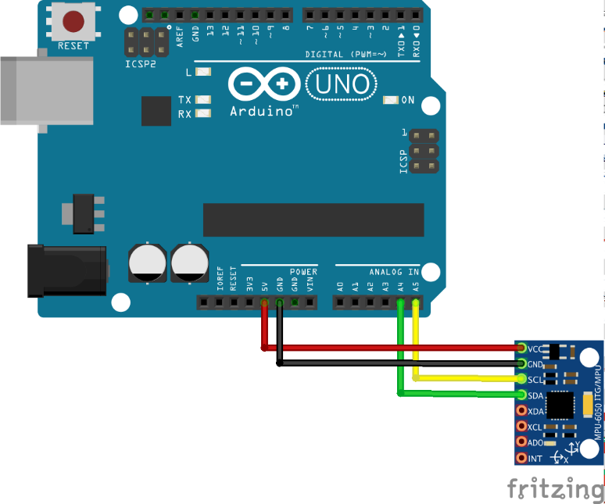
MPU6050 Triple Axis Gyroscope & Accelerometer
https://github.com/afai79/Arduino/blob/main/Lib/Arduino-MPU6050-master.zip

Slide 42
Day 5
Arduino Robot – An easy DIY project
We are going to build an Arduino based robot capable of avoiding obstacles in its path.
It is a fun project and a great learning experience, so without any further delay, let us get started!
https://educ8s.tv/arduino-robot-easy-diy-project/
https://github.com/afai79/Arduino/tree/main/ArduinoRobot

Slide 43
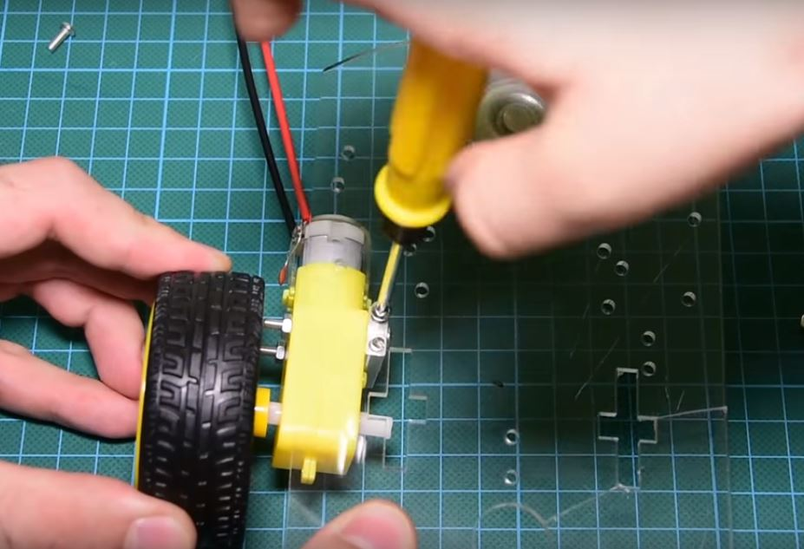
Building the Robot
Step 1. Connect the motor and wheels to the chassis.

Slide 44
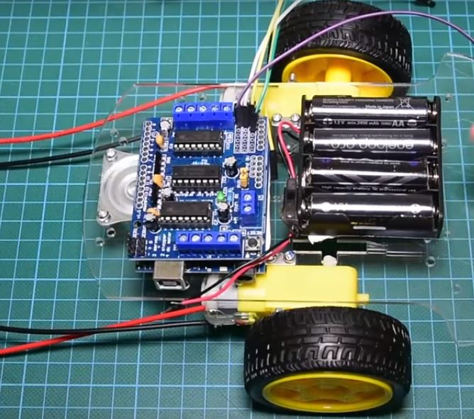
Step 2: Prepare the Switch and connect the Power Source
Step 3: Mount other Parts on the chassis.

Slide 45
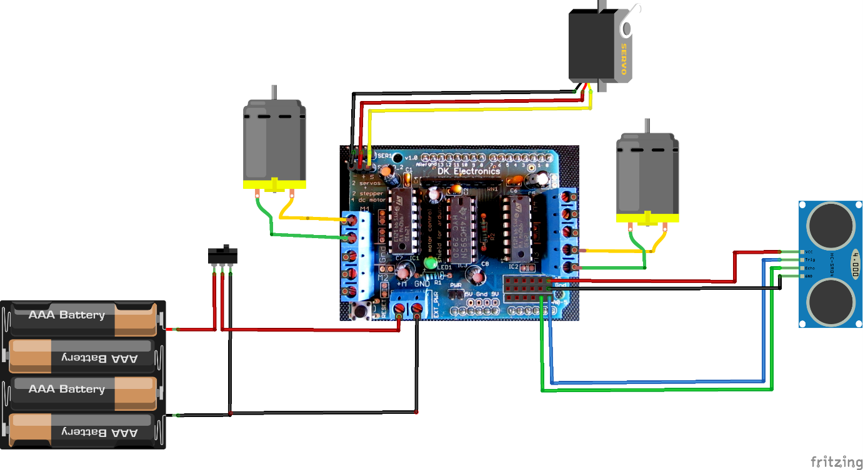
Schematics
Wire up the components together as shown in the image below.

Slide 46
Code
The code uses three libraries.
Two of them must be downloaded for the program to compile.
The first one is the motor shield driver from Adafruit.
The second library is the NewPing library for the supersonic distance sensor.
https://github.com/afai79/Arduino/blob/main/ArduinoRobot/ArduinoRobot_.ino

Slide 47
LIBRARIES
Motor Shield Library:
https://github.com/afai79/Arduino/blob/main/ArduinoRobot/Adafruit-Motor-Shield-library-master.zip
New Ping Library:
https://github.com/afai79/Arduino/blob/main/ArduinoRobot/NewPing_v1.9.1.zip

Slide 48
End of Training!

